Slide 1
Awesome Web Server
Eric Summers & Woody Thompson

Slide 2
Motivation
Web servers suffer heavy traffic
Scale out
Parallelize request fulfillment
Web servers suffer uneven traffic
Make elastic
Add or remove resources on-demand
Saves resources
Necessitates good load balancing

Slide 3
Challenges
Communication between machines
MPI abstracts away for us
Dispatching requests to workers
Use HTTP 307 Redirect
Resource management
Selecting workers to service requests
Thresholds for turning workers on and off

Slide 4
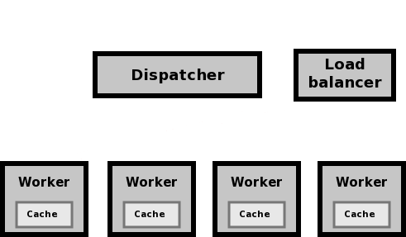
Setup

Slide 5

Request Flow
Dispatcher receives HTTP request

Slide 6
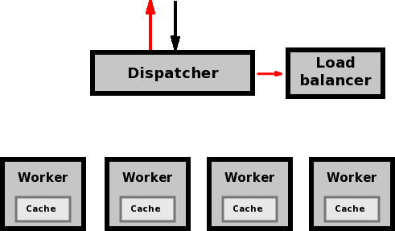
Request Flow
Dispatcher sends redirect to client
Dispatcher updates Load Balancer

Slide 7
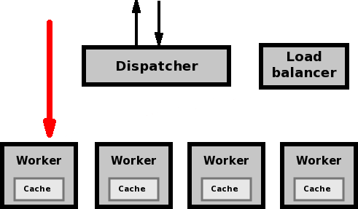
Request Flow
Worker receives redirected HTTP request

Slide 8
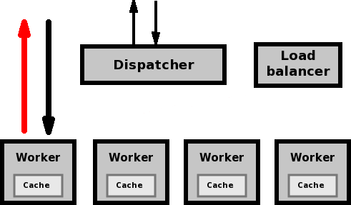
Request Flow
Worker sends HTTP response

Slide 9
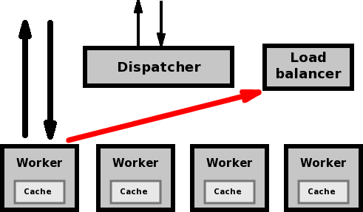
Request Flow
Worker updates Load Balancer

Slide 10
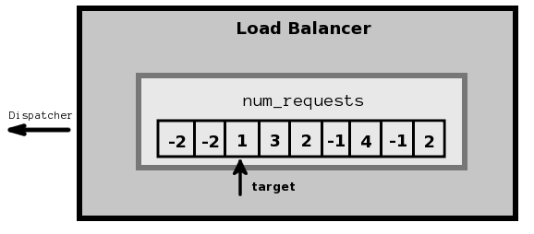
Load Balancing
Instruct Dispatcher to redirect to target
Turn workers on/off based on load factor
Updated by dispatcher and workers

Slide 11
Performance Testing
48 requesters across 12 machines
Bring online three testers every five seconds
Each tester fires as many requests as possible for 100 seconds

Slide 12
Results

Slide 13
Results

Slide 14
Results

Slide 15
Conclusions
Higher overall cache space improves performance
Generally linear scaling
Requests completely data-parallel
Only potential bottleneck at dispatcher
Elasticity generally worth it

Slide 16
Possible Optimizations
Add request forwarding
Faster than redirection
Beyond scope of course
Smarter load balancing
Based on average latency?
Further tweaking critical values
Elasticity thresholds
Cache parameters/design
Cache network

Slide 17
Acknowledgements
Kayvon Fatahalian (and Mike & Michael)
For teaching the course, and providing ideas for features to implement on the server
Randal Bryant and David O’Hallaron
For tiny server starter code from 15-213
Cardellini, Colajanni, and Yu
For their paper Dynamic Load Balancing on Web-server Systems provided our HTTP redirection idea

